Slide 1
UbiCom Book Slides
Chapter 4
Smart Mobile Devices, Networks & Cards
Stefan Poslad
http://www.eecs.qmul.ac.uk/people/stefan/ubicom
Ubiquitous computing: smart devices, environments and interaction

Slide 2
Introduction
Chapter 4 focuses on:
Internal system properties: distributed system & on sub-property of mobility
External interaction with other ICT systems in its virtual computing environment.
Ubiquitous computing: smart devices, environments and interaction

Slide 3
Links to Related Sections
Mobile human devices, e.g., wearables and implants (Chapter 5)
Robots as a mobile host (Chapter 6)
Mobile devices in form of dust (Chapter 6)
Location-awareness often quoted as a key killer app for mobile devices (Chapter 7)
Management of mobile devices (Chapter 12)
Future for mobile devices (Chapter 13)
Ubiquitous computing: smart devices, environments and interaction

Slide 4
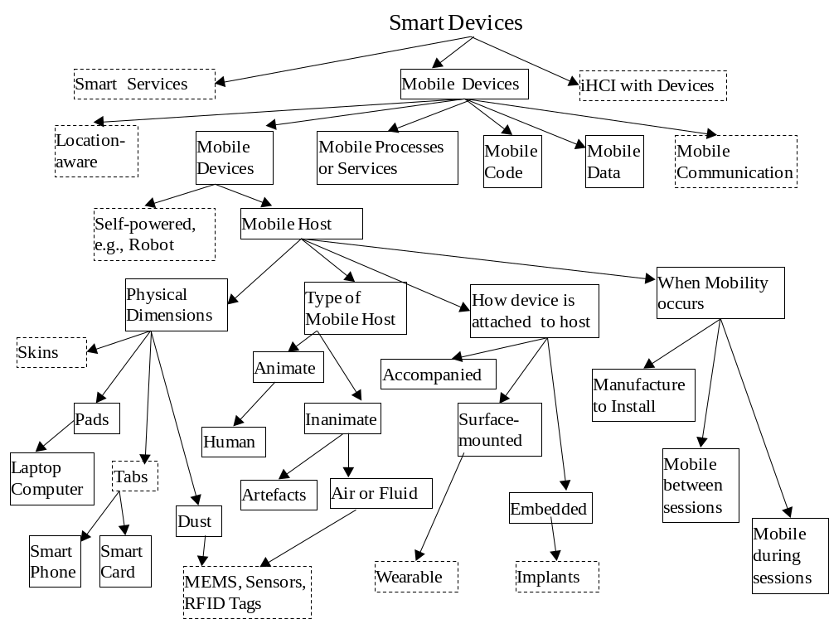

Slide 5
Introduction
The slides for this chapter are also expanded and split into several parts in the full pack
Part A: Mobility Dimensions & Design
Part B: Mobile Services
Part C: Mobile device OS
Part D: Cards Devices and Device Networks
Ubiquitous computing: smart devices, environments and interaction

Slide 6
Overview
Smart Mobile Device Characteristics √
Mobile Code & Service Design Principles
Mobile Service Design
SMS, WAP & I-Mode Mobile Services
Mobile Device OS
Smart Card Devices
Device Networks
Ubiquitous computing: smart devices, environments and interaction

Slide 7
Smart Mobile Devices
Mobile Smart Device
  Enable devices to access services ubiquitously
Smart mobile devices are driven by ↑ capability to embed
Variety of form factors
↑ Wireless? LAN, WAN access to Internet, voice, video etc.
Mobile devices themselves are often not mobile!
Ubiquitous computing: smart devices, environments and interaction

Slide 8
Smart Mobile Device Characteristics
What are these?
Ubiquitous computing: smart devices, environments and interaction

Slide 9
Dimensions of Mobility
Mobility is a very rich concept.
Some important dimensions of mobility
  Mobile devices
  Mobile services ( also see Chapter 3)
  Mobile data
  Mobile code
  Mobile communication (also see Chapter 11)
  Mobile context (also see Chapter 7)
Ubiquitous computing: smart devices, environments and interaction

Slide 10
Dimensions of Mobility for Devices
Sometimes mobile devices are not mobile
  Mobile host & non-mobile device vs. mobile device
Type of mobile host?
Physical dimensions of mobile device?
How a non-mobile device is attached to a mobile host?
When the mobility occurs, during the operational life-cycle.
Ubiquitous computing: smart devices, environments and interaction

Slide 11
Mobility Dimensions: When Mobility Occurs
Different degrees of mobility
Relative (from home) versus absolute (untethered)
Mobile host versus mobile device
How is device attached to mobile host?
  Accompanied, Surface mounted, embedded
Ubiquitous computing: smart devices, environments and interaction

Slide 12
Overview
Smart Mobile Device Characteristics
Mobile Code & Service Design Principles √
Mobile Service Design
SMS, WAP & I-Mode Mobile Services
Mobile Device OS
Smart Card Devices
Device Networks
Ubiquitous computing: smart devices, environments and interaction

Slide 13
Mobile Code
Enables providers to maintain, e.g., upgrade and fix, code in consumer devices with a network connection
Installation requires configuring code on each platform.
Mobile code languages: Java, C#, Postscript, etc
Some Mobile Cole Models allow code to move during operation / between sessions
Ubiquitous computing: smart devices, environments and interaction

Slide 14
Mobile Code
Enables providers to maintain, e.g., upgrade and fix, code in consumer devices with a network connection
Installation requires configuring code on each platform.
Mobile code languages
  E.g.,
Some Mobile Cole Models allow code to move during operation / between sessions
Ubiquitous computing: smart devices, environments and interaction

Slide 15
Mobile Code: Pros and Cons
Benefits?
Cons?
Ubiquitous computing: smart devices, environments and interaction

Slide 16
Mobile Code: Security
Several main approaches to mobile code security:
Sandboxes
Code signing
Firewalls
Proof-carrying code (PCC)
Ubiquitous computing: smart devices, environments and interaction

Slide 17
Mobile Code: Designs
Mobile code design varies according to where code executes and who determines when mobility occurs:
Client-server / remote evaluation interaction (Chapter 3)
Code on demand (versus Software as a Service Model (Chapter 3, 12)
Process migration
Mobile agents
Active networks (Chapter 11)
Ubiquitous computing: smart devices, environments and interaction

Slide 18
Overview
Smart Mobile Device Characteristics
Mobile Code & Service Design Principles
Mobile Service Design √
SMS, WAP & I-Mode Mobile Services
Mobile Device OS
Smart Card Devices
Device Networks
Ubiquitous computing: smart devices, environments and interaction

Slide 19
Mobile Service Design (Overview)
Transparent Service access
Data Access
Data Management on Mobile Device
Networking
Volatile Network Links
Ubiquitous computing: smart devices, environments and interaction

Slide 20
Mobile Service Design: Transparent Service Access
To simplify service access whilst mobile, various transparencies are useful. Why? What?
Where should Transparency be handled?
Should Client applications designed to be aware of mobile changes?
  What are the Pros and cons?
Ubiquitous computing: smart devices, environments and interaction

Slide 21
Mobile Service Design: Transparent Service Access
3 kinds of transparency for middleware
User Virtual Environments (UVE)
Mobile Virtual Terminals (MVT)
Virtual Resource Management (VRM)
Ubiquitous computing: smart devices, environments and interaction

Slide 22
Mobile Service Design: Data Access
How do we manage all the content we access on the mobile phone?
How do service deal with heterogeneous terminal capabilities, Web Browsers?
Dumb approach to content adaptation
Access specialised Mobile portal content vs. adapt content on the fly from any Web portal?
  (See Section 7.6)
Ubiquitous computing: smart devices, environments and interaction

Slide 23
Mobile Service Design: Data Management on the Mobile Device
Mobile devices may create new local data that may be business sensitive or personal.
Denial of Service (DoS) can occur when mobile device gets stolen or left behind.
Solutions to handle temporary DoS?
Data synchronisation is needed
Solutions to handle temporary DoS, e.g., permanently lost
Ubiquitous computing: smart devices, environments and interaction

Slide 24
Mobile Service Design: Wireless Networking
Do we need new protocols for wireless?
Or do we need to specialize/optimize existing protocols?
Protocols optimised for wireless
  e.g., cellular devices
  Data exchange protocols for wireless end-loops
  Data presentation for mobile terminals (Chapter 7)
  Design? thin client-server model, terminal only does presentation (Chapter 3)
  Management and security? (Chapter 12)
Ubiquitous computing: smart devices, environments and interaction

Slide 25
Mobile Service Design: Volatile Network Links
Wireless network links may be volatile for a variety of reasons (Chapter 11)
Hence Mobile Services must be designed to be volatile.
  There are a variety of designs (Chapter 3)
Ubiquitous computing: smart devices, environments and interaction

Slide 26
Overview
Smart Mobile Device Characteristics
Mobile Code & Service Design Principles
Mobile Service Design
SMS, WAP & I-Mode Mobile Services √
Mobile Device OS
Smart Card Devices
Device Networks
Ubiquitous computing: smart devices, environments and interaction

Slide 27
Mobile Service Design: SMS
What is SMS?
SMS (short messaging service) for GSM / 2G.
Network service characteristics?
Use of gateways
Ubiquitous computing: smart devices, environments and interaction

Slide 28
Mobile Service Design: SMS
Advantages?
Limitations?
Because of limitations, WAP developed but SMS still used more than
Ubiquitous computing: smart devices, environments and interaction

Slide 29
Mobile Service Design: WAP
WAP (Wireless Application Protocol) - Advantages over SMS?
Two WAP versions v1 & v2
Earlier WAP was a separate standards body but since 2003, part of the OMA (Open Mobility Alliance) which covers everything
Ubiquitous computing: smart devices, environments and interaction

Slide 30
Mobile Service Design: WAP V1 vs V2
??
Ubiquitous computing: smart devices, environments and interaction

Slide 31
Mobile Services: 3-Tier Client-Proxy-Server Model
See Chapter 3
Ubiquitous computing: smart devices, environments and interaction

Slide 32
Mobile Service Design: I-mode
Mobile information service launched by NTT DoCoMo of Japan in Feb 1999
Based on proprietary technology
  Japanese PDC-P (Personal Digital Cellular-Packet)
Compelling (and profitable) cHTML content
Single browser (Access) on multiple handsets
Handsets designed for the service, rather than technology
Cheap to use (packet-based costs not time-based)
End to end
Ubiquitous computing: smart devices, environments and interaction

Slide 33
Mobile Service Design: c-HTML/i-mode
Ubiquitous computing: smart devices, environments and interaction

Slide 34
Android & i-phone
Ubiquitous computing: smart devices, environments and interaction

Slide 35
Overview
Smart Mobile Device Characteristics
Mobile Code & Service Design Principles
Mobile Service Design
SMS, WAP & I-Mode Mobile Services
Mobile Device OS √
Smart Card Devices
Device Networks
Ubiquitous computing: smart devices, environments and interaction

Slide 36
Operating System (OS)
OS: system software that:
  Controls/abstracts hardware
  Manages resources and processes to support different applications
OS enables user applications to be ↑ simpler & device-independent
  Applications use API to access hardware and OS
3 main resources of system are Managed. What?
In mobile, resource constrained devices additional resources are managed. What?
  Power (See Section 4.3)
  UI & Content (See Section 7.6.1.2
Ubiquitous computing: smart devices, environments and interaction

Slide 37
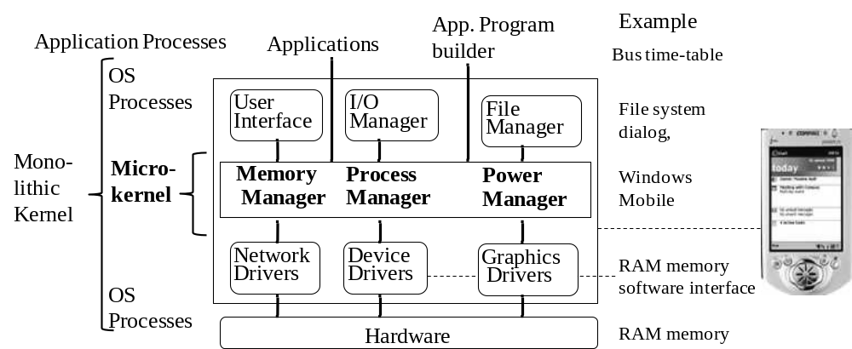
Operating System
Ubiquitous computing: smart devices, environments and interaction

Slide 38
OS: Macro kernel
Macro-Kernel (Monolithic Kernel)
Everything in One Single Large Kernel
Benefits? (for mobile device use):
Drawbacks? for mobile device use):
Ubiquitous computing: smart devices, environments and interaction

Slide 39
OS: Micro-Kernel
Only fundamental parts in kernel.
Benefits (for mobile device use):
Drawbacks (for mobile device use):
Ubiquitous computing: smart devices, environments and interaction

Slide 40
Symbian OS
Specifically designed as an OS for mobile devices.
Has a multi-tasking kernel
Has a POSIX compliant interface and a JVM
Etc
Ubiquitous computing: smart devices, environments and interaction

Slide 41
Mobile OS: Process Control
How to support multi-tasking in a mobile device OS?
Connectivity requires an operating system with genuine multi-tasking, communications-capable real-time performance
  E.g., in order to talk, count-down set alarms and run & access data & applications on phone, at same time
  e.g., Symbian OS
Alternatively, system can schedule 1 task at a time,
  wait for it to complete
  then switch to another (non-pre-emptive task scheduling)
  e.g., Palm OS
Ubiquitous computing: smart devices, environments and interaction

Slide 42
Mobile OS Design: Static vs Dynamic Process Scheduling
Static: all scheduling decisions determined before execution
  ???
Dynamic: run-time decisions are used
  .
Ubiquitous computing: smart devices, environments and interaction

Slide 43
Mobile OS design: Scheduling CPU Usage
Pre-emptive scheduling:
  .
Non-pre-emptive scheduling: vs. run to completion .
  .
Ubiquitous computing: smart devices, environments and interaction

Slide 44
Mobile OS: Memory Management
Memory Management
Kernel should be small.
Good resource / Memory management needed
System resources should be released as soon as they are no longer needed
Ubiquitous computing: smart devices, environments and interaction

Slide 45
Mobile OS Design: Memory
In the past, phone devices retain information in memory as long as the battery held a charge.
Now, permanent storage in the form of Flash ROM
Mobile devices boot from ROM & load data more slowly.
On the other hand, ROM memory uses less power
N.B. earlier types of ROM such as Compact Flash had a limited lifetime in terms of read/writes.
Ubiquitous computing: smart devices, environments and interaction

Slide 46
Mobile OS: Power Management
Requirements
If Mobile devices’ hardware resources are fully powered up all the time, often only a fraction of power is being used:
Device needs to be responsive in all situations. How?
Devices should not be powered down completely. Why?
Competing processes/ users scheduled to receive, a fair share of battery (power) resources rather than CPU resources,
Ubiquitous computing: smart devices, environments and interaction

Slide 47
Mobile OS: Power Management
Design
Dynamic Voltage Scaling (DVS)
DVS+SRT
Ubiquitous computing: smart devices, environments and interaction

Slide 48
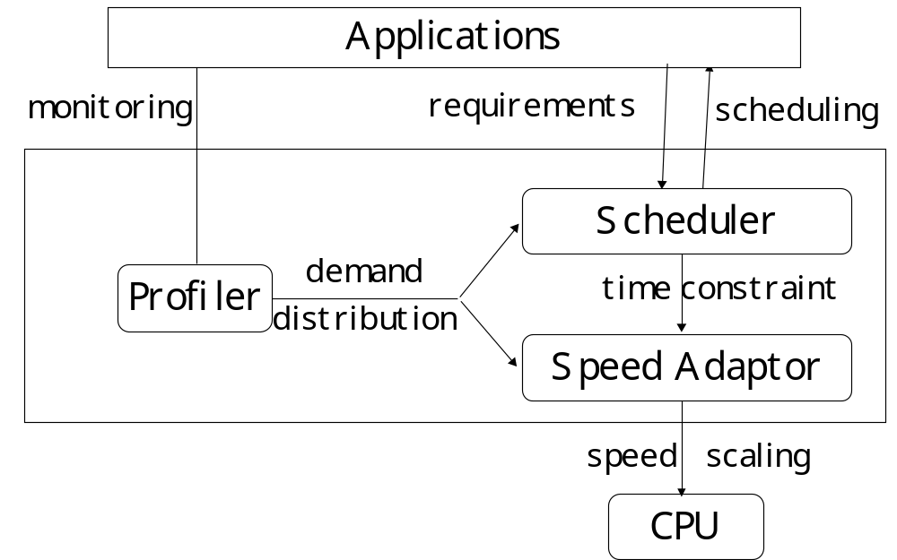
Mobile OS: Power Management
Ubiquitous computing: smart devices, environments and interaction

Slide 49
Mobile Device Power Management
Miscellaneous Issues
Focus here (Chapter 4) has been on power management of Tab and pad type devices.
Power management for dust type mobile devices (Chapter 6)
Low power, eco-friendly issues are (Section 13.5.2)
Ubiquitous computing: smart devices, environments and interaction

Slide 50
Mobile OS: Combined Process & Power Scheduling
Ubiquitous computing: smart devices, environments and interaction

Slide 51
Overview
Smart Mobile Device Characteristics
Mobile Code & Service Design Principles
Mobile Service Design
SMS, WAP & I-Mode Mobile Services
Mobile Device OS
Smart Card Devices √
Device Networks
Ubiquitous computing: smart devices, environments and interaction

Slide 52
Smart Cards
Type of chip card constructed out of substrate, e.g., plastic
  .
Just about anything found in a person’s wallet has the potential to be stored on a smart card, what?
Ubiquitous computing: smart devices, environments and interaction

Slide 53
Smart Cards vs. Smart Phones
???
Ubiquitous computing: smart devices, environments and interaction

Slide 54
Smart Cards
1977: Motorola, Bull produced 1st smart card microchip
2009: Add latest figures about Smart Card use today
2010+: Multiple plastic cards could “meld into 1 universal, multifunctional. smart card
Chip may be memory only or CPU & memory
Data associated with either value or information or both is stored and processed within the card
No inbuilt user interface for I/O
ard data is transacted via a card reader or wireless base-station
Ubiquitous computing: smart devices, environments and interaction

Slide 55
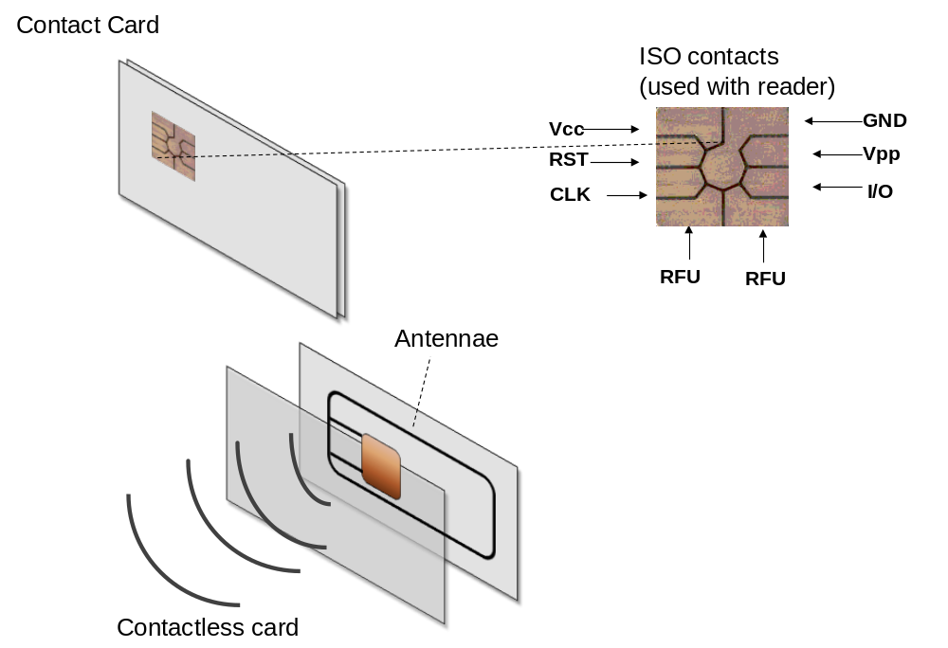
Smart Card: Hardware Interface
Ubiquitous computing: smart devices, environments and interaction

Slide 56
Smartcard Types: Contact vs. Contactless
‘Contact’ cards
Card inserted in reader
Physical contact made
Contactless’ card
Uses RF transceiver / transponder chip
Card is ‘waved’ in immediate vicinity of a reader or base-station
Ubiquitous computing: smart devices, environments and interaction

Slide 57
Smartcard Types: Contact vs. Contactless
???
Ubiquitous computing: smart devices, environments and interaction

Slide 58
Smart cards: SIM cards
Subscriber Identity Module (SIM
Used in GSM mobile phones to authorise subscriber access to cellular network
SIM cards securely identify a subscriber.
SIM card allows users to change phones by swapping SIM cards
1st larger, credit-card sized) SIM Card was made in 1991
Later, miniature-versions appeared
Ubiquitous computing: smart devices, environments and interaction

Slide 59
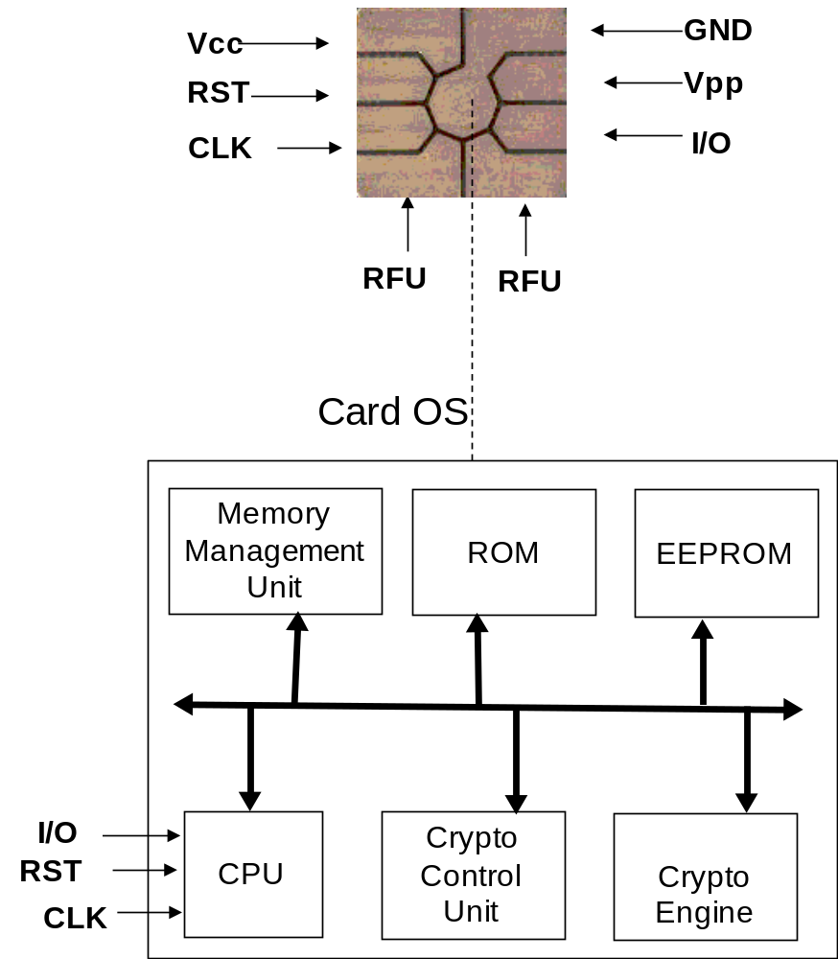
Smart Card: Operating System
Ubiquitous computing: smart devices, environments and interaction

Slide 60
Smart Card Application Design: System & Environment Requirements
Upgradable
Security?
Contactless vs. Contact Card design
Wireless RF: operating range & data rate
Ubiquitous computing: smart devices, environments and interaction

Slide 61
Smart Card: Application Requirements
Primary tasks of smart card operating system on behalf of an application:
Transferring data to and from the smart card
Controlling the execution of commands
Managing files
Managing and executing cryptographic algorithms
Managing and executing program code.
Ubiquitous computing: smart devices, environments and interaction

Slide 62
Smart Card APIs: Java Card
Java Card refers to a technology that allows small Java-based applications (applets) to be run securely on smart cards and similar small memory footprint devices.
Java Card is the tiniest of Java targeted for embedded devices. Java Card gives developers the ability to program the device and make them application specific.
Widely used in SIM cards (used in GSM mobile phones) and ATM cards.
First Java Card was introduced in 1997
Ubiquitous computing: smart devices, environments and interaction

Slide 63
Smart Cards: Java CardVM
Java Card applications are Java Card bytecode run in a Java CardVM
Uses a different encoding optimized for size.
Java Card applet typically uses less bytecode than the hypothetical Java applet obtained by compiling the same Java source code.
Conserves memory
Techniques exist for overcoming the size limitation of 64 KB limit
Java CardVM runs in many smart cards even a GSM phone SIM card
Ubiquitous computing: smart devices, environments and interaction

Slide 64
Development of Java Smart Card Application (applet)
There are 4 steps comprise the Java Card applet development:
Specify the functions of the applet
  E.g., security function requires the user to enter a PIN, card locks after three unsuccessful attempts to enter the PIN.
Request and assign AIDs to both the applet and the package containing the applet class
Design the class structure of the applet programs
Define the interface between the applet and the terminal application
Develop using the JavaCard development kit
  See http://java.sun.com/products/javacard/dev_kit.html
Ubiquitous computing: smart devices, environments and interaction

Slide 65
More about Smart Card Application Development
Ubiquitous computing: smart devices, environments and interaction

Slide 66
Advances in Smart Cards
??
Ubiquitous computing: smart devices, environments and interaction

Slide 67
Overview
Smart Mobile Device Characteristics
Mobile Code & Service Design Principles
Mobile Service Design
SMS, WAP & I-Mode Mobile Services
Mobile Device OS
Smart Card Devices
Device Networks √
Ubiquitous computing: smart devices, environments and interaction

Slide 68
Device Networks
Objective of a device network is to enable a wide variety of devices to interoperate.
Applications:
  home automation, e.g., light and climate control,
  person-aware systems
  home security, care in the community
  pervasive AV content access (Section 2.3.2.1).
  etc
Ubiquitous computing: smart devices, environments and interaction

Slide 69
Devices versus Services
Can a device simply be abstracted & modelled as a service?
Ubiquitous computing: smart devices, environments and interaction

Slide 70
Device Networks: Characteristics & Challenges
Characteristics
????
Challenges
??
Ubiquitous computing: smart devices, environments and interaction

Slide 71
Device Networks: Network Technologies
InfraRed
BlueTooth
X10
HAVi
HES
UPnP
Jini
OSGi
WiFi,
DECT
3G mobile phone networks
Ubiquitous computing: smart devices, environments and interaction

Slide 72
Device Networks: Device Discovery
Network Discovery:
  ????
Device / service discovery:
  Jini,
  UPnP
  IETF’s SLP,
  DNS Service Discovery
  Bluetooth’s SDP
Device / service execution / management
  OSGi
Ubiquitous computing: smart devices, environments and interaction

Slide 73
Open Services Gateway Initiative (OSGi)
OSGi promotes open specifications for the delivery of managed services into networked environments such as homes & automobiles.
Initial market for OSGi was home services gateways, e.g., in video broadcast set top boxes, broadband modems.
These then act as a gateway, between the end user (and owner) of the devices on a LAN, and the service providers that could be accessible over the Internet who want to providers (i.e., sellers) of services
Ubiquitous computing: smart devices, environments and interaction

Slide 74
Open Services Gateway Initiative (OSGi)
Core OSGi platform specification:
  ???.
OSGi in turn uses underlying Java VM (Section 4.2.1.2) and OS services (Chapters 3 and 4)
Application services are encapsulated, deployed in bundles
Event-driven mgt. mechanisms support installation, activation, deactivation, update, and removal of bundles.
Typical OSGi service framework implementation
  .
Ubiquitous computing: smart devices, environments and interaction

Slide 75
Overview
Smart Mobile Device Characteristics √
Mobile Code & Service Design Principles √
Mobile Service Design √
SMS, WAP & I-Mode Mobile Services √
Mobile Device OS √
Smart Card Devices √
Device Networks √
Ubiquitous computing: smart devices, environments and interaction

Slide 76
Summary & Revision
For each chapter
See book web-site for chapter summaries, references, resources etc.
Identify new terms & concepts
Apply new terms and concepts: define, use in old and new situations & problems
Debate problems, challenges and solutions
See Chapter exercises on web-site
Ubiquitous computing: smart devices, environments and interaction

Slide 77
Exercises: Define New Concepts
Mobile code, etc
Ubiquitous computing: smart devices, environments and interaction

Slide 78
Exercise: Applying New Concepts
What are the main design challenges in developing mobile code?
etc
Ubiquitous computing: smart devices, environments and interaction

